Slide 1
HACMP 5.X 概念和实施规划
Advanced Technical Support
IBM Technical Support Center

Slide 2

目录
  什么是HACMP
  配置HACMP的规划和考虑
  HACMP的安装和配置
  HACMP的客户化和管理

Slide 3
目录
  什么是HACMP?
  配置HACMP的规划和考虑
  HACMP的安装和配置
  HACMP的客户化和管理

Slide 4

HACMP—(High Availability Cluster Multi Processing)
  为什么需要高可用性？
    越来越多的应用成为关键应用
    越来越多的业务提供7*24小时服务
    越来越多的客户意识到自己是上帝
    ------ IBM 公司的解决方案: HACMP
  什么是HACMP？
  1) High Availability：
    系统可用性或运行时间最大化
    系统宕机时间最小化
  2) multi-processing？
    一个cluster里的各个节点上可以运行多个应用
    共享数据或并发访问数据.
    不是容错机（ fault tolerance )

Slide 5
HACMP for AIX Supplies Clustering Components
Cluster Manager (clstrmgrES)
Event Scripts
Lock Manager (cllockd) – removed from HACMP 5.2
SNMP Agent(clsmuxpd)
clinfo
clcomd (HACMP 5.1 and later)

Slide 6
Cluster Manager
Cluster Manager runs on all nodes in the cluster (clstrmgrES)
  - "Brains" of HACMP that finds symptoms, diagnoses
problems, and applies remedies
- Monitors and responds to changes in cluster state
- Synchronizes and coordinates actions within the
cluster
  - Executes Event Scripts in response to changes in
cluster state

Slide 7
Event Scripts
Event Scripts determine action to be taken in response to cluster events
HACMP includes event scripts that provide the behavior that is appropriate for most environments
The specific response to an event is easily customized
Event scripts are written in the default shell and use standard AIX commands and HACMP utilities

Slide 8
Cluster Lock Manager
(removed from HACMP 5.2)
In Concurrent Access environments, multiple nodes can simultaneously access the same data
Applications must be written using the Cluster Lock Manager API to register,request and release locks
The Lock Manager coordinates and serializes access to shared data to prevent data inconsistencies and corruption

Slide 9
clinfo & clsmuxpd
clinfo is the Cluster Information daemon
A clinfo API is provided that allows application programs to determine the current state of the cluster and to take appropriate action in response to changes
clinfo also executes a whenever an event occurs within the cluster; this script may be customized
clinfo communications is SNMP-based, relying on a SNMP sub-agent(clsmuxpd) to receive updates on cluster status
The clinfo daemon is optional on both cluster nodes and client systems

Slide 10
HACMP Detects and Response to the Following Types of Failures
Node Failures
-Processor hardware or operationg system failures
-One or more surviving nodes can acquire resources
Network Adapter Failures
Move IP address to standby network adapter in same node
Network Failure
-Message displayed on console and event is logged
-As every site's network configurations are unique , no other default action is taken
-Action to be taken in response to network failures is customizable
Application Failure
  - Application monitoring

Slide 11
What about other types of failures?
Disk Drive Failures
-LVM Mirroring
-RAID Disk Devices
Other Hardware Failure
Application Failure(Customization needed , SRC)
HACMP Failure
-Promoted to node failure
Power Failure
-Avoid common power supplies across replicated devices
-Use a UPS

Slide 12
Definitions
Cluster
up to 32 server nodes working together,using TCP/IP for communication and each running the Cluster Manager daemon(program)
Node
Individual machine that is a member of a cluster and running the Cluster Manager daemon . This is an arbitrary string of 30 characters (alphanumeric and underscore, but cannot start with a number).
Resources
Entities that are controlled by a node and are taken over by another node in the event of a node failure
-Disks, Volume Groups , file systems
-NFS exported file systems
-IP Addresses
-Application Programs
These entities are configured into Resource Groups
Critical Application
An application that is started and stopped under the control of HACMP, For example , a database backend.

Slide 13
Definitions(Cont.)
Event
Something that happens in a cluster -a change in cluster state: node down/up, network down/up, network adapter failure etc.
Behavior
What you would like the cluster to do in response to an EVENT. This behavior is controlled by shell scripts
Reintegration
The process of bringing a previously failed node , network, or network adapter back into the cluster.

Slide 14

HACMP V5.x的新特点
ALL IN ONE:
在HACMP v5之前，每个版本的HACMP软件都有四个模块，HAS，CRM，ES和ESCRM，用户在定购的时候根据需要选择其中一个模块，从HACMP v5开始IBM只提供一个模块，包括以前四个模块的所有功能。
简化了HACMP Cluster的配置与管理
通过磁盘传输心跳信号(Heartbeat over Disk)
IPAT通过Alias实现(IPAT via Alias)(缺省方式)
用户自定义的资源组(Custom RG)
快递磁盘接管(Fast Disk Takeover)
HACMP-XD
高可用性

Slide 15
目录
  什么是HACMP?
  配置HACMP的规划和考虑
  HACMP的安装和配置
  HACMP的客户化和管理

Slide 16

配置HACMP的规划和考虑
  Cluster / Node 规划
  Recourse规划
    IP网络及地址（Service IP、Non-Service IP、Persistent IP）
    Heartbeat网络（IP、串口、共享硬盘）
    Volume Group and File System
    Application Server
  Recourse Group规划
  Software的规划
    操作系统的版本和补丁要求
    HACMP的版本和补丁要求
    应用程序的兼容性

Slide 17
Cluster/ Node规划: Node配置要求 (1)
Cluster / Node
  一个精心设计的cluster应该尽量避免单点故障（SPOF),为了达到这个目的，典型的cluster一般对硬件有如下要求:
      至少2个 pseries 服务器作为cluster的节点（安装并运行HACMP,每个节点的AIX 版本和HACMP的版本要完全一致)
      内置硬盘：预留一定的硬盘空间满足HACMP的安装要求, MIRROR
      I/O插槽：要满足网卡、HBA卡（阵列和带库要分开）、串口卡
      至少一种non-IP 网络，通常采用RS232网络，如果某些节点集成串口无法作心跳，要配#2943 8口异步卡，节点间要配串口线
      一个共享磁盘阵列（7133/FastT/ESS等)

Slide 18
Node配置要求(2)：cluster性能考虑
Cluster / Node
  为了保证cluster的性能，一个cluster支持的最大组件数目如下：
      组件 最大数目
      node 32
      Resource Groups 64
      Networks 48
      Network interface,devices, and labels 256

Slide 19

Resource: IP网络规划
Resource
  用户的IP网络类型要求
    Support: Ethernet, Token ring, FDDI , ATM
    Not support: SOCC,SLIP, FCS
  用户的IP网络资源规划
    Switch
    VLAN
    IPAT 方式
    IP地址规划

Slide 20
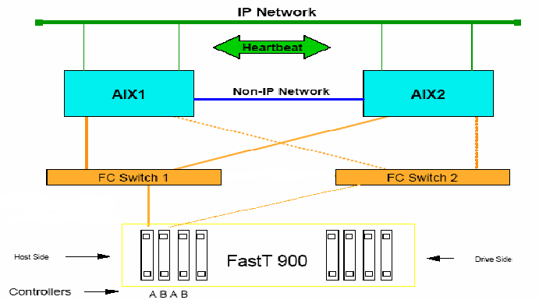
IP网络规划：网络连接示意图
Resource
test1_boot1
test1_boot2
test2_boot1
test2_boot2
Concept
How HA
Network Connection
Two IPAT method (From version 4.5)
test1
test2

Slide 21
Concept:
Boot IP: 网卡的初始IP地址, AIX启动后使用的地址
Service IP: 对外服务的地址, 会从一块网卡切换到另一块网卡
Standby IP: 不再需要.

Slide 22
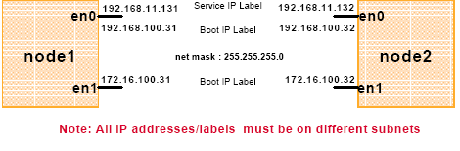
IP网络规划： IPAT via IP aliases（一）
Resource
  Non-service labels 在 AIX 启动时分配
  在 HACMP 启动后 ,service IP label 作为一个alias 添加到一块带有non-service label 的network interface上
  non-service label 从来都不会从一个 NIC上移走
  如果节点失败 , 一个 takeover 节点会获得失败节点的 service IP label ，并作为一个 alias 添加到它的位于同一个HACMP network 里的一块带有non-service label 的network interface上

Slide 23
IP网络规划： IPAT via IP aliases（二）
Resource
  设置 IPAT via IP aliases 功能
  #smitty hacmp
  Extended Configuration >
  Extended Topology Configuration >
  Configure HACMP Networks >
  Change/Show a Network in the HACMP Cluster >
  Change/Show an IP-Based Network in the HACMP Cluster
  Change/Show an IP-Based Network in the HACMP Cluster
  Type or select values in entry fields.
  Press Enter AFTER making all desired changes.
  [Entry Fields]
  * Network Name net_ether_01
  New Network Name []
  * Network Type [ether] +
  * Netmask [255.255.255.0] +
  * Enable IP Address Takeover via IP Aliases [Yes] +
  IP Address Offset for Heartbeating over IP Aliases []
  * Network Attribute public +

Slide 24
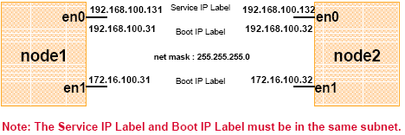
IP网络规划： IPAT via IP replacement
Resource
  Non-service labels 在 AIX 启动时分配
  HACMP 启动后 ,service IP label 替换（replaces） non-service IP label
  如果节点失败 , 一个 takeover 节点使用它的位于同一个HACMP network里的一个 non-service interface 来获得（acquire)失败节点的service IP label

Slide 25
IP网络规划： Persistent Node IP label
Resource
  Persistent Node IP label
  是一个 IP alias ，它可以分配给cluster里的一个特定节点
    How config -> extend configuration -> rc.net
    总是位于同一个节点
    可以位于一块已经拥有 service 或 non-service IP label 的网卡上
    不需在节点上安装额外的物理网卡
    不属于任何资源组
    能被用于对指定的节点进行管理
    每个节点可配置多个.
    在节点启动后即可用，当HACMP服务停止后也始终保持可用
    如果网卡失败，它只会迁移到相同网络的同一个节点上的其它网卡
    如果节点失败，该IP标识不会迁移到群集中的其它节点

Slide 26
Heartbeat网络规划
Resource
  确定用户的Non-IP网络（心跳）
    串口方式
    IP网络方式
    硬盘方式

Slide 27
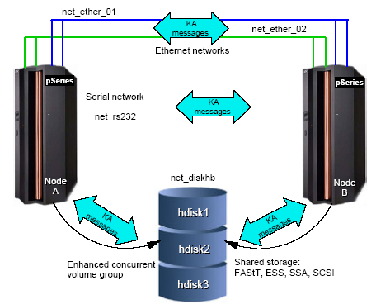
Heartbeat网络规划：磁盘心跳（Heartbeat via disk)
Resource
  HACMP5.1的新功能
  能够使用下列任何一种共享磁盘阵列 (Fibre Channel, SCSI, 或 SSA)
  使用的磁盘是一个 enhanced concurrent volume group 的一部分, 唯一的要求是这个 VG必须在两个节点都有定义
  磁盘的这块特殊区域不能用作任何的 LVM 操作, 而只能用来在两个节点间传递心跳消息

Slide 28

Volume Group and File System规划
Resource
  确定存储设备的连接类型
    SCSI
    SSA
    FC
  了解用户需求划分存储资源
    划分RAID
    创建逻辑盘
  确定VG的类型
    Non-concurrent
    Concurrent
    Enhanced concurrent
  确定文件系统类型
    jfs2
    Jfs

Slide 29
Volume Group and File System规划：
Enhanced concurrent Volume Group
Resource
  使用RSCT 进行通信
  支持 ACTIVE 和 PASSIVE 模式
    ACTIVE Varyon: 类似通常的 varyon
    PASSIVE Varyon: 不允许 高级操作（high level operations ）
  HACMP 协调节点间的活动，保证只有一个节点可以 vary on volume group actively
  enhanced concurrent volume groups 能够被包含在一个 non-concurrent resource groups里
  Enhanced concurrent volume groups in AIX 5.1 and 5.2

Slide 30
Resource
Volume Group and File System规划：
快速磁盘接管（fast disk takeover)（一）
  通过提供快速资源组fallover，减少宕机时间
  对于2块硬盘的VG，接管时间一般不超过10秒。
  对于带有大数量磁盘的VG的资源组有显著的性能提高。
  需要enhanced concurrent volume groups 定义在 non-concurrent resource groups里
  对于位于共享盘阵上enhanced concurrent volume groups，如果是共享资源组的资源， HACMP 会自动实现快速磁盘接管.
  Our suggestion.

Slide 31
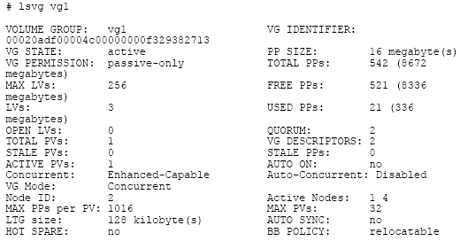
Volume Group and File System规划：
快速磁盘接管（fast disk takeover)（二）
Resource
  你可以查看vg的状态通过 lsvg 命令：
  VG STATE 无论是actively 或者passively方式的varyon，都将显示active状态。
  VG PERMISSION 如果是actively方式的varyon ，将显示read/write，如果是passive方式的varyon ，将显示passive-only。
  CONCURRENT 将显示Capable或者Enhanced-Capable (对于concurrent vg).

Slide 32
Resource Group规划
Resource Group
一些可管理的资源集合在一起，和特定的应用相关联，并可一同执行 failover等行为的组.
包含四种类型：
    Cascading resource group
    Rotating resource group
    Concurrent resource group
    Custom resource group（HA 5.X新增的资源组类型）

Slide 33
Cascading Resource Group:
Resource Group
  缺省，资源会在优先级最高的节点上启动
  低优先级的节点作为standby节点，当高优先级节点fail的时候接管其资源
  当发生失败节点重新加入（reintegration）时，资源会返回到优先级更高的节点
  每个节点都可以配置自己的资源成为 multi-takeover的方式
  资源（Resources）:
  Service IP Labels/Addresses
  Volume Groups
  Filesystems
  Application Servers
优先级

Slide 34
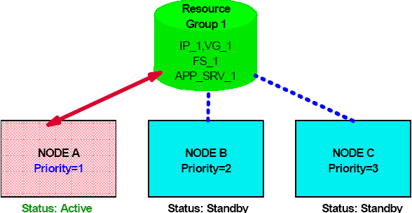
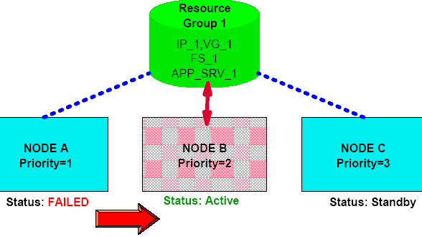
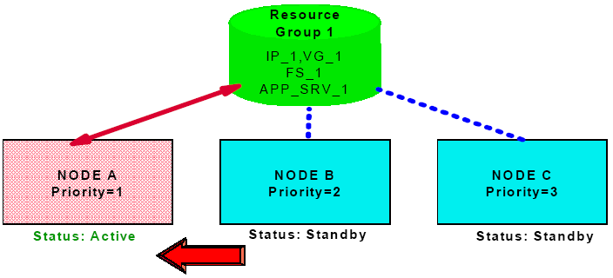
Cascading resource group的接管过程
Resource Group

Slide 35
Cascading resource group的属性
Resource Group
Cascading 资源组提供下面三种属性，这些属性需要在hacmp的Extended configuration菜单中设置。
Cascading without fallback
Inactive takeover
Dynamic node priority
  Cl_highest_free_mem – select the node with the highest percentage of free memory
  Cl_highest_idle_cpu – select the node with the most avialable processor time
  Cl_lowest_disk_busy – select the disk that is least busy

Slide 36
Rotating resource group:
Resource Group
  第一个加入到资源组的节点会获得资源
  当节点失败 ,第一个备(standby)节点会获得失败节点的资源组
  一个失败节点重新加入cluster，将会作为备(standby)节点，不会重新获得原来的资源组
  资源（Resources）:
  Service IP Labels/Addresses
  Volume Groups
  Filesystems
  Application Servers

Slide 37
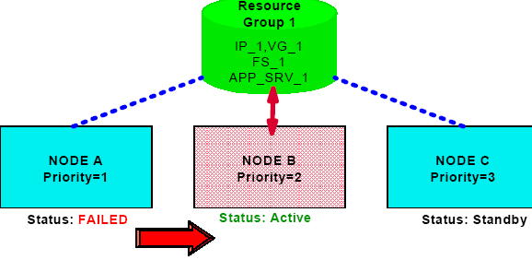
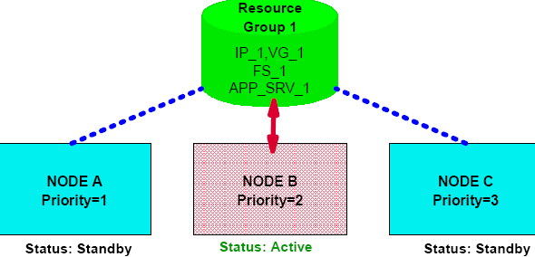
Rotating resource group的接管过程
Resource Group

Slide 38
Concurrent resource group:
Resource Group
  所有的节点共享且可并发访问数据
  应用在所有节点上并行运行
  有Lock Manager 协调各节点对数据的访问
  一个节点失败，会降低cluster 性能，但不会发生接管。
  资源（Resources）:
  Concurrent Volume Groups
  Application Servers
共享盘阵

Slide 39
Custom resource group
Resource Group
  HACMP5.1 增加的新类型
  HACMP 5.2 CUSTOM ONLY
  通过参数设置 ,可以精确定义有关资源组的 startup,failover 和fallback行为的策略
  资源（Resources）:
  Service IP Labels/Addresses
  Volume Groups
  Use forced varyon of volume groups, if necessary [false]
  Filesystems
  Application Servers

Slide 40
Custom resource group
Resource Group
  添加一个custom resource group :
  #smitty hacmp
  Initialization and Standard Configuration >
  Configure HACMP Resource Groups >
  Add a Resource Group >
  Cascading
  Rotating
  Concurrent
  Custom
  Add a Custom Resource Group
  Type or select values in entry fields.
  Press Enter AFTER making all desired changes.
  [Entry Fields]
  * Resource Group Name [ ]
  * Participating Node Names (Default Node Priority) [ ] +
  Startup Policy Online On Home Node O> +
  Fallover Policy Fallover To Next Prio> +
  Fallback Policy Fallback To Higher Pr> +

Slide 41
Custom resource group
Resource Group
Startup | 可设置的策略有： • Online on Home Node Only. The resource group should be brought online only on its home (highest priority) node during the resource group startup. This requires the highest priority node to be available. • Online on First Available Node. The resource group activates on the first participating node that becomes available. • Online on All Available Nodes. The resource group is brought online on all nodes. • Online Using Distribution Policy. Only one resource group is brought online on a node, or on a node per network, depending on the distribution policy specified (node or network).
Fallover | 可设置的策略有 • Fallover to Next Priority Node in the List. In the case of fallover, the resource group that is online on only one node at a time follows the default node priority order specified in the resource group’s nodelist. • Fallover Using Dynamic Node Priority. Before selecting this option, configure a dynamic node priority policy that you want to use. Or you can select one of the three predefined dynamic node priority policies. • Bring Offline (on Error Node Only). Select this option to bring a resource group offline on a node during an error condition
Fallback | 可设置的策略有 • Fallback to Higher Priority Node in the List. A resource group falls back when a higher priority node joins the cluster. If you select this option, you can use the delayed fallback timer. If you do not configure a delayed fallback policy, the resource group falls back immediately when a higher priority node joins the cluster. • Never Fallback. A resource group does not fall back when a higher priority node joins the cluster

Slide 42
Custom resource group
Resource Group
在HACMP5.2 以前资源组的定义 | 在HACMP5.2中资源组的定义
Cascading resource group Inactive Takeover = False Cascading without Fallback (CWOF) = False | •Startup: Online on Home Node Only •Fallover: Fallover to Next Priority Node in the List •Fallback: Fallback to Higher Priority Node in the List
Cascading resource group Inactive Takeover = True CWOF = False | •Startup: Online on First Available Node • Fallover: Fallover to Next Priority Node in the List •Fallback: Fallback to Higher Priority Node in the List
Cascading resource group Inactive Takeover = False CWOF = True | •Startup: Online on Home Node Only •Fallover: Fallover to Next Priority Node in the List •Fallback: Never Fallback
Cascading resource group Inactive Takeover = True CWOF = True | •Startup: Online on Fisrt Available Node •Fallover: Fallover to Next Priority Node in the List •Fallback: Never Fallback
Rotating resource group | •Startup: Online Using Distribution Policy •Resource Group Distribution Policy: Network distribution •Fallover: Next Priority Node in the List •Fallback: Never Fallback
Concurrent resource group | •Startup: Online on All Available Nodes •Fallover: Bring Offline (On Error Node Only) •Fallback: Never Fallback

Slide 43
配置要求
Software
操作系统上需要打的一些额外的包：
bos.adt.lib bos.adt.libm
bos.adt.syscalls bos.net.tcp.client
bos.net.tcp.server bos.rte.SRC
bos.rte.libc bos.rte.libcfg
bos.rte.libcur bos.rte.libpthreads
bos.rte.odm bos.data
如果需要安装并行的资源组，需要打下面的包：
bos.rte.lvm. 5.1.0.25 or higher
bos.clvm.enh.

Slide 44
目录
  什么是HACMP?
  配置HACMP的规划和考虑
  HACMP的安装和配置
  HACMP的客户化和管理

Slide 45
HACMP软件的安装
需要安装的组件
操作系统的补丁
HACMP软件
HACMP软件的补丁
软件的安装方法
NIM
光盘安装
本地硬盘安装
验证安装

Slide 46
HACMP软件的配置过程
HACMP配置前的准本工作
配置IP地址
编辑/etc/hosts文件
编辑/usr/es/sbin/cluster/etc/rhosts 文件
编写应用程序的启动/停止脚本
创建共享的vg和文件系统
配置串口设备
HACMP的Standard配置过程
  添加Cluster和节点
配置Cluster资源
创建并配置Cluster资源组
同步HACMP的配置
HACMP的Extended配置过程
  添加心跳
定制Cluster资源

Slide 47
HACMP软件配置方案拓扑图
test1_boot1
test1_boot2
test2_boot1
test2_boot2
test1
test2

Slide 48
HACMP配置前的准备工作：配置IP地址
test1:/>netstat -in
Name Mtu Network Address Ipkts Ierrs Opkts Oerrs Coll
en0 1500 link#2 0.4.ac.49.f2.d5 77960 0 47805 0 0
en0 1500 100.1 100.1.0.1 77960 0 47805 0 0
en1 1500 link#3 0.6.29.ec.44.d6 33 0 11 0 0
en1 1500 192.168.0 192.168.0.1 33 0 11 0 0
test2:/>netstat -in
Name Mtu Network Address Ipkts Ierrs Opkts Oerrs Coll
en0 1500 link#2 0.4.ac.49.60.23 31138 0 82582 0 0
en0 1500 100.1 100.1.0.2 31138 0 82582 0 0
en1 1500 link#3 0.4.ac.3e.b9.4b 36 0 13 0 0
en1 1500 192.168.0 192.168.0.2 36 0 13 0 0

Slide 49
HACMP配置前的准备工作：编辑配置文件
编辑/etc/hosts文件
100.1.0.2 test2_boot1 test2
100.1.0.1 test1_boot1 test1
192.168.0.1 test1_boot2
192.168.0.2 test2_boot2
10.1.0.1 test1_svc
10.1.0.2 test2_svc
10.1.0.5 test1_per
10.1.0.6 test1_per
编辑/usr/es/sbin/cluster/etc/rhosts 文件
100.1.0.2
100.1.0.1
192.168.0.1
192.168.0.2

Slide 50
HACMP配置前的准备工作：编写脚本
查看节点上的应用服务器的启动/停止脚本
test2:/ha51>ls –l
-rwxr-xr-x 1 root system 65 Apr 13 13:51 start
-rw-r--r-- 1 root system 31 Apr 13 11:49 start.log
-rwxr-xr-x 1 root system 66 Apr 13 14:01 start1
-rw-r--r-- 1 root system 31 Apr 13 14:01 start1.log
-rwxrwxrwx 1 root system 64 Apr 13 11:48 stop
-rw-r--r-- 1 root system 31 Apr 13 11:48 stop.log
-rwxr-xr-x 1 root system 66 Apr 13 14:01 stop1
-rw-r--r-- 1 root system 31 Apr 13 14:01 stop1.log
启动脚本举例：
vi start
date >> /ha51/start.log
banner " start app1 " >> /tmp/hacmp.out

Slide 51
HACMP配置前的准备工作：创建共享的VG和FS
test1vg是共享VG：
test1 :
hdisk0 0004383268b07574 rootvg active
hdisk3 000438325e22bca7 test1vg
hdisk4 00043832125e5aa8 None
hdisk5 000438323d0e4487 None
test2 :
hdisk0 000d29574085126d rootvg active
hdisk5 000438325e22bca7 test1vg
hdisk6 00043832125e5aa8 None
hdisk7 000438323d0e4487 None

Slide 52
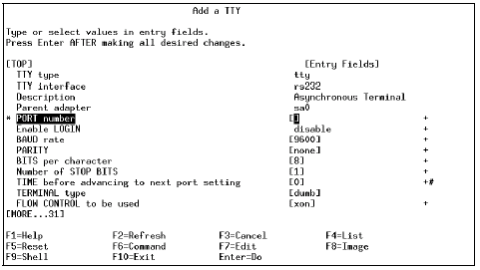
HACMP配置前的准备工作：创建串口设备
通过smitty tty命令来添加串口设备：

Slide 53
HACMP的Standard配置过程：添加CLUSTER和节点
通过smitty hacmp命令，按照下列路径来添加Cluster和节点：
-> Initialization and Standard Configuration
-> Add Nodes to an HACMP Cluster。
* Cluster Name [ha51tsc]
New Nodes (via selected communication paths) [test2_boot1 test1_boot1]
Currently Configured Node(s)
注：这一步很重要，一般我们都是把每个节点的boot1 作为communication path . 当回车以后，系统会自己discover hacmp 的资源，并有详细的信息显示输出。

Slide 54
HACMP的Standard配置过程：
添加高可用资源Service IP
通过smitty hacmp命令，按照下列路径来添加Service IP：
-> Initialization and Standard Configuration
-> Configure Resources to Make Highly Available
-> Configure Service IP Labels/Addresses
-> Add a Service IP Label/Address
* IP Label/Address [test1_svc ]
Network Name [net_ether_02 ]
* IP Label/Address [test2_svc ]
Network Name [net_ether_02 ]
注：如果有多个应用服务器，则添加多个Service IP。

Slide 55
HACMP的Standard配置过程：
添加高可用资源Application Server
通过smitty hacmp命令，按照下列路径来添加Application Server：
-> Initialization and Standard Configuration
-> Configure Resources to Make Highly Available
-> Configure Application Servers
-> Add an Application Server
* Server Name [app1]
* Start Script [/ha51/start]
* Stop Script [/ha51/stop]
注：如果有多个应用服务器，则添加多个Application Server。

Slide 56
HACMP的Standard配置过程：
添加高可用资源VG和FS（一）
注意在前面的步骤中我们看到已经有一个共享VG test1vg 存在了，它使用传统的方法：
  在test1 节点上创建test1vg , lv,jfs
  Varyoffvg
  在test2 上 importvg
  Varyoffvg
我们也可以用hacmp的功能去创建test2vg 和文件系统

Slide 57
HACMP的Standard配置过程：
添加高可用资源VG和FS（二）
通过smitty hacmp命令，按照下列路径来添加共享VG：
-> Initialization and Standard Configuration
-> Configure Resources to Make Highly Available
-> Configure Volume Groups, Logical Volumes and Filesystems
-> Shared Volume Groups
->Create a Shared Volume Group
Node Names test1,test2
PVID 00043832125e5aa8
VOLUME GROUP name [test2vg ]
Physical partition SIZE in megabytes 4
Volume group MAJOR NUMBER [49]

Slide 58
HACMP的Standard配置过程：
添加高可用资源VG和FS（三）
通过smitty hacmp命令，按照下列路径来添加共享FS：
-> Initialization and Standard Configuration
-> Configure Resources to Make Highly Available
-> Configure Volume Groups, Logical Volumes and Filesystems
-> Shared File Systems
-> Journaled File Systems
->Add a Journaled File System
->Add a Standard Journaled File System
Node Names test1,test2
Volume group name test1vg
* SIZE of file system [10 ]
* MOUNT POINT [/test1jfs]
PERMISSIONS read/write
Mount OPTIONS []
Start Disk Accounting? no
Fragment Size (bytes) 4096
Number of bytes per inode 4096
Allocation Group Size (MBytes) 8

Slide 59
HACMP的Standard配置过程：创建Cluster资源组
通过smitty hacmp命令，按照下列路径来添加资源组：
-> Initialization and Standard Configuration
-> Configure HACMP Resource Groups
-> Add a Resource Group
Cascading
Rotating
Concurrent
Custom
* Resource Group Name [res1]
* Participating Node Names / Default Node Priority [test1 test2]
注：如果有多个资源组，则按照同样方法添加即可。

Slide 60
HACMP的Standard配置过程：配置Cluster资源组
通过smitty hacmp命令，按照下列路径来配置资源组：
-> Initialization and Standard Configuration
-> Configure HACMP Resource Groups
-> Change/Show Resources for a Resource Group (standard)
Resource Group Name res1
Participating Node Names (Default Node Priority) test1 test2
* Service IP Labels/Addresses [test1_svc] Volume Groups [mtest1vg] Filesystems (empty is ALL for VGs specified) [/test1jfs] Application Servers [mapp1]
注：如果有多个资源组，则按照同样方法配置即可。

Slide 61
HACMP的Standard配置过程：同步HACMP的配置
通过smitty hacmp命令，按照下列路径来检查HACMP的配置：
-> Initialization and Standard Configuration
-> Display HACMP Configuration
显示输出如右图所示。如果检查没有问题，就可以做同步了：
-> Initialization and Standard Configuration
-> Verify and Synchronize HACMP Configuration
Cluster Description of Cluster: ha51tsc
Cluster Security Level: Standard
There are 2 node(s) and 1 network(s) defined
NODE test1:
Network net_ether_02
test2_svc 10.1.0.2
test1_svc 10.1.0.1
NODE test2: …
Resource Group res1
Behavior cascading
Participating Nodes test1 test2
Service IP Label test1_svc

Slide 62
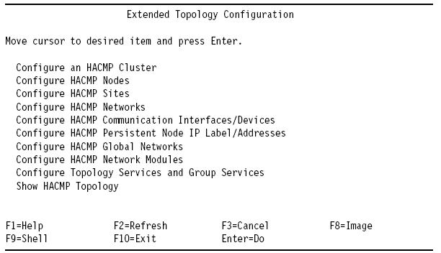
HACMP的Extended配置过程
在Extended Configuration中我们还可以配置 tty 心跳 网络 ， hdisk 心跳网络，Persistent Node IP ，application monitor 等等。

Slide 63
HACMP的Extended 配置过程：设置hdisk心跳网络（一）
首先，我们要一个 Enhanced concurrent VG , 这个vg 不需要一定是放在concurrent 资源组里的vg , 当然也可以用concurrent 资源组里的硬盘来做心跳网络。这个concurrent vg 可以通过两种方法来建立。
方法一：
Mkvg –c convg ；在一个节点上varyoffvg , 另一个节点上importvg
方法二：
通过smitty hacmp命令，按照下列路径来添加hdisk心跳盘：
-> Initialization and Standard Configuration
-> Configure Resources to Make Highly Available
-> Configure Concurrent Volume Groups and Logical Volumes
-> Concurrent Volume Groups
-> Create a Concurrent Volume Group

Slide 64
HACMP的Extended 配置过程：设置hdisk心跳网络（二）
Node Names test1,test2
PVID 000438323d0e4487
VOLUME GROUP name convg
PhysicalpartitionSIZEinmegabytes 4
Volume group MAJOR NUMBER [49]
Enhanced Concurrent Mode true
其次，检查hdisk 网络的状况，在一个节点上向hdisk 写数据，从另一个节点上读数据，很像 我们在配置tty 网络之前，检查一下tty 是否连通。
Add /usr/sbin/rsct/bin/ to /etc/environment 里的path 中
重新login test1 和test2 使path 生效
在test1 上运行：dhb_read -p hdisk5 –r
在test2 上运行：dhb_read -p hdisk7 –t

Slide 65
HACMP的Extended 配置过程：设置hdisk心跳网络（三）
通过smitty hacmp命令，按照下列路径来添加hdisk心跳网络：
-> Extended Configuration
-> Extended Topology Configuration
-> Configure HACMP Networks
-> Add a network to the HACMP Cluster
# Pre-defined Serial Device Types
diskhb
rs232
tmscsi
tmssa
* Network Name[m [net_diskhb_01]
* Network Type diskhb

Slide 66
HACMP的Extended 配置过程：设置hdisk心跳网络（四）
通过smitty hacmp命令，按照下列路径来添加hdisk心跳网络的接口设备：
-> Extended Configuration
-> Extended Topology Configuration
-> Configure HACMP Communication Interfaces/Devices
-> Add Communication Interfaces/Devices
-> Add Pre-defined Communication Interfaces and Devices
-> Communication Devices
* Device Name [heartbeatdisk5]
* Network Type diskhb
* Network Name net_diskhb_01
* Device Path [/dev/hdisk5]
* Node Name [test1]
注：需要对cluster的所有节点都进行设置，做完之后，需要对hacmp进行检查和同步。

Slide 67
HACMP的Extended 配置过程：设置串口心跳网络
通过smitty hacmp命令，按照下列路径来添加RS232类型的网络：
-> Extended Configuration
-> Extended Topology Configuration
-> Configure HACMP Networks
-> Add a network to the HACMP Cluster
通过smitty hacmp命令，按照下列路径来添加RS232类型的接口设备：
-> Extended Configuration
-> Extended Topology Configuration
-> Configure HACMP Communication Interfaces/Devices
-> Add Communication Interfaces/Devices
-> Add Pre-defined Communication Interfaces and Devices
-> Communication Devices
注：需要对cluster的所有节点都进行设置，做完之后，需要对hacmp进行检查和同步。

Slide 68
HACMP软件的Extended 配置：设置persistent IP label
通过smitty hacmp命令，按照下列路径来配置persistent IP label：
-> Extended Configuration
-> Extended Topology Configuration
-> Configure HACMP Persistent Node IP Label/Addresses
-> Add a Persistent Node IP Label/Address
* Node Name test1
* Network Name net_ether_02
Node IP Label/Address test1_per
注：persistent IP配置并同步完成后，该ip立即被绑定到boot1上。

Slide 69
目录
  什么是HACMP?
  配置HACMP的规划和考虑
  HACMP的安装和配置
  HACMP的客户化和管理

Slide 70
Cluster Customization
Event Customization
  standard HACMP events : node_up, node_down,
  network_down,swap_adapter...
  path: /usr/sbin/cluster/events
Pre- and post event
Event Notification
Event Recovery

Slide 71
Cluster Administration
Start/Stop Cluster
Test Cluster
Backup Cluster Definition
Cluster Trouble Shooting
Change Shared/Concurrent LVM Components
Change Cluster Resource/Topology
  Change
  Sync

Slide 72
Start/Stop Cluster
Start cluster
  Start all the cluster nodes sequentially:
    1. automaticacly start at booting time
    2. smit hacmp
    --> cluster service managment
    --> Start the Cluster
    3. smit clstart
    4. command line: rc.cluster

Slide 73
Start/Stop Cluster(Cont.)
Stop Cluster
-- stop all the Cluster Node Sequentially:
  1. smit hacmp
  2. smit clstop
-- stop mode:
graceful(release resource), force , takeover
-- Note:
  shutdown system by shutdown command -- not takeover

Slide 74
Test Cluster
Power Off Box
Plug out network cable
Ifconfig en# down
stop cluster with takeover mode e.g:
  #clstop -gr
Shutdown not takeover
monitoring cluster takeover results:
  ifconfig -a -->Service IP takeover ?
  lsvg -o --> vg takeover or varyon ?
  df -->fs mounted ?
  ps -ef -->application started ?
  tail -f /tmp/hacmp.out

Slide 75
Backup/Restore Cluster
Snapshot utility
Add a cluster snapshot to save cluster info
  create two text files:.odm file and .info file
  path: /usr/sbin/cluster/snapshots
Applying a cluster snapshot to restore a cluster info
Send your cluster snapshot(.info and .odm files) to ask help

Slide 76
What’s New in HACMP 5.4

Slide 77
HACMP 5.4: Simpler
Expanded and standardized Smart Assist Framework for Automatic Application Discovery and Configuration. Has a common look-and-feel with other Smart Assistants and allows for simpler management of clusters with selected applications
Enhanced Smart Assist for Oracle provides assistance to those involved with the installation of Oracle Application Server and/or Oracle Database Manage
Improved and extended WebSMIT provides an easier-to-use GUI with enhanced functionality for easier management of the HACMP cluster
Enhanced Cluster Test Tool provides several additional test scenarios, enabling more thorough validation of the cluster configuration

Slide 78
HACMP 5.4: Simpler (Cont)
Manual Resource Group Movement Enhancements for better usability
Enhancements to “Forced Down” enable customers to better manage scheduled maintenance and unscheduled downtime
Customers are now able to start cluster services without disrupting their application service, thereby allowing better quality of service
Customers will be able to upgrade to new PTF levels and new releases without disrupting their application service

Slide 79
HACMP 5.4: Faster & Smarter
Cluster Verification facilities continue to be expanded, to better help customers prevent problems before they occur
Fast Failure Detection allows for faster detection of node failures on certain cluster configurations
HACMP now supports Linux on System p hardware with a selected feature set, enabling customers to utilize the proven capabilities of HACMP in a Linux environment

Slide 80
HACMP 5.4: Goes the Distance
HACMP/XD GLVM enhancements allow customers to utilize up to four data mirroring networks, as well as to use Enhanced Concurrent Volume Groups with GLVM
Support GPFS 2.3 to allow customers to use a cluster-wide filesystem
IPAT support on Geographic Networks to allow for better utilization of network resources
HACMP/XD for Metro Mirror support leverages customers’ storage and Metro Mirror investment for business resilience

Slide 81
Software Dependencies
HACMP 5.4 and HACMP/XD 5.4 requires one of the following:
  AIX 5L 5.2 TL8 with RSCT version 2.3.9 (IY84921) or higher
  AIX 5L 5.3 TL4 with RSCT version 2.4.5 (IY84920) or higher
64-bit kernel support requires PSSP 3.5 on the SP
  Note: AIX 5L 5.3 and later do not support the SP

Slide 82
Packaging and Migration Notes
New Filesets:
  cluster.msg.en_US.glvm
  cluster.msg.En_US.glvm
  cluster.msg.ja_JP.glvm
  cluster.msg.Ja_JP.glvm
Removed Filesets:
  cluster.es.clvm.rte
GLVM cluster internationalized messages are included in the cluster.msg.LANG.glvm fileset
cluster.es.clvm.rte functionality – The use of concurrent resource groups and concurrent volume groups is enabled with base HACMP. The license key that was created by the fileset is no longer required for operation

Slide 83
Packaging and Migration Notes (Cont)
HACMP no longer requires a reboot
  During Install, All HACMP subsystems are automatically started
  During an upgrade starting with HACMP 5.4 PTF 1, all HACMP subsystems will automatically be stopped during an upgrade and restarted upon completion
The SPPRC ODMs, HACMPspprc and HACMPsdisksubsys have moved from the cluster.es.spprc fileset to the cluster.es fileset to facilitate an easier migration path

Slide 84
Packaging and Migration Notes (Cont)
GEO_primary and GEO_secondary network types are no longer supported. These network types are now converted to XD_data networks
SNMP daemon is restarted during installation
  Any SNMP client applications should be restarted after an installation of HACMP

Slide 85
HACMP for Linux 5.4
High Availability Cluster Multi-Processing for Linux v.5.4 is the first release of HACMP on the Linux platform. HACMP for Linux will be supported on Power architecture machines
The following Linux versions will be supported:
  Red Hat Enterprise Linux (RHEL) 4
  SUSE LINUX Enterprise Server (SLES) 9
Additional installation requirements:
  RSCT 2.4.5.2
  Apache WebServer V1 or V2 (provided with the Linux distribution)
  ksh93

Slide 86
HACMP for Linux 5.4 (Cont)
RPM
  hacmp.client
  hacmp.server
  hacmp.doc.html
  hacmp.doc.pdf

Slide 87

Q&A:

